Slide 1
End of Capstone III
Grant
Slide 1 of 13
Presenters: Grant Saylor, Kyle Smith, Anthony Tran, Jiayi Xu

Slide 2

End of Capstone III
Grant
Slide 1 of 13
Presenters: Grant Saylor, Kyle Smith, Anthony Tran, Jiayi Xu
Notes:
Hi everyone, this is Grant Saylor speaking. We are Libraworks and our app is Virtual Library. In this presentation, myself, Kyle, Anthony and Jiayi will present demos to showcase the refinements that have been done since the end of Capstone 2. First though I’ll start with a refresher of what Virtual Library is.

Slide 3

A Refresher on Virtual Library
Grant
Slide 2 of 13
Virtual Library is an Android application layer on top of existing free-little libraries in your neighborhood.
The app facilitates ease-of-use and a sense of connectedness.
Designed in Kotlin
Speaker: Grant Saylor
Notes:
As you may remember, Virtual Library is an Android application that is used to check out books from your neighborhood little libraries. The value add of Virtual Library is the ability to see libraries on a map and the collection of books contained within, all without having to leave your house. When you’ve decided on a library to visit all you have to do is utilize the barcode scanner to check out a title, this lets other users know that your book is not available.
The development team consists of myself, Grant Saylor, along with Kyle Smith, Anthony Tran and Jiayi Xu and is designed in Kotlin for Android devices. Each individual screen in our app, known as activities, has their user interface designed in XML.

Slide 4
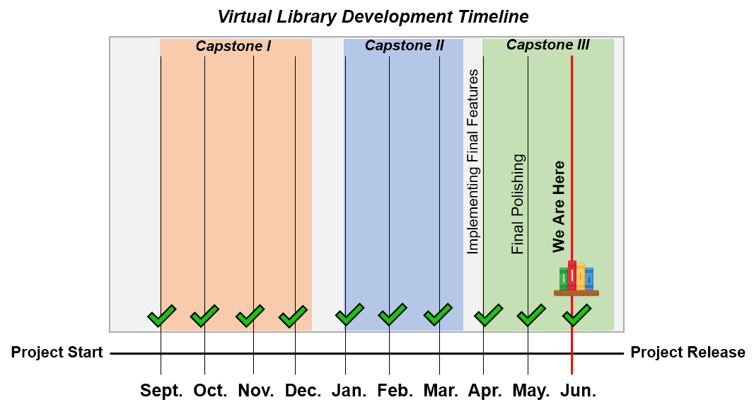
Where We Are in Development
Grant
Slide 3 of 13
The app is at its first release candidate!
Core features are implemented
Ready to publish to Google Play
Speaker: Grant Saylor
Notes:
Since you last saw a showcase of our app, at the end of capstone 2 we had implemented a rough version of most technologies that we wished to use. Since then, we’ve refined implementations by teaching ourselves more modern ways to implement functionality, such as infinite scroll instead of button presses to change pages. The app is in its release candidate form and we’re ready to publish to Google Play.

Slide 5
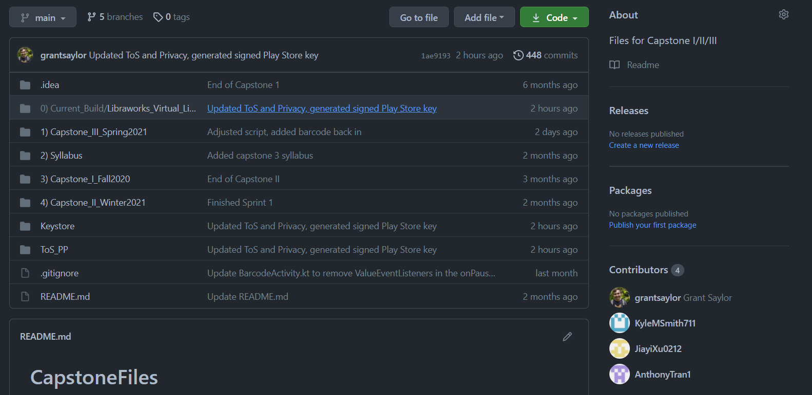
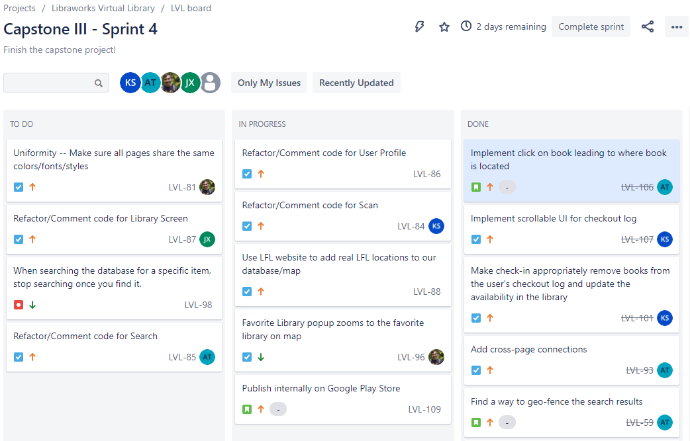

Technologies and Methods used to Manage Virtual Library
Grant
Slide 4 of 13
Jira
GitHub
Daily Meetings
SCRUM-like development process
Speaker: Grant Saylor
Notes:
During the development of Virtual Library, we utilized a SCRUM-like development process where we met daily at 2pm to work on our project. It was important for us to simulate an in-person capstone experience, so to achieve this we created a server to discuss, share documents, video conference and more to replicate being at the same table in the Bellevue College lab rooms. This was extremely beneficial to us as it allowed our work to be supremely organized and always ready to find at the touch of a button.
Additionally, we each had our own branch on GitHub for each piece of the project which we would then merge into the main branch as a stable build. In conjunction with GitHub, we used Jira, a sprint management tool to divide the work into tasks so we were never too behind in our work.

Slide 6
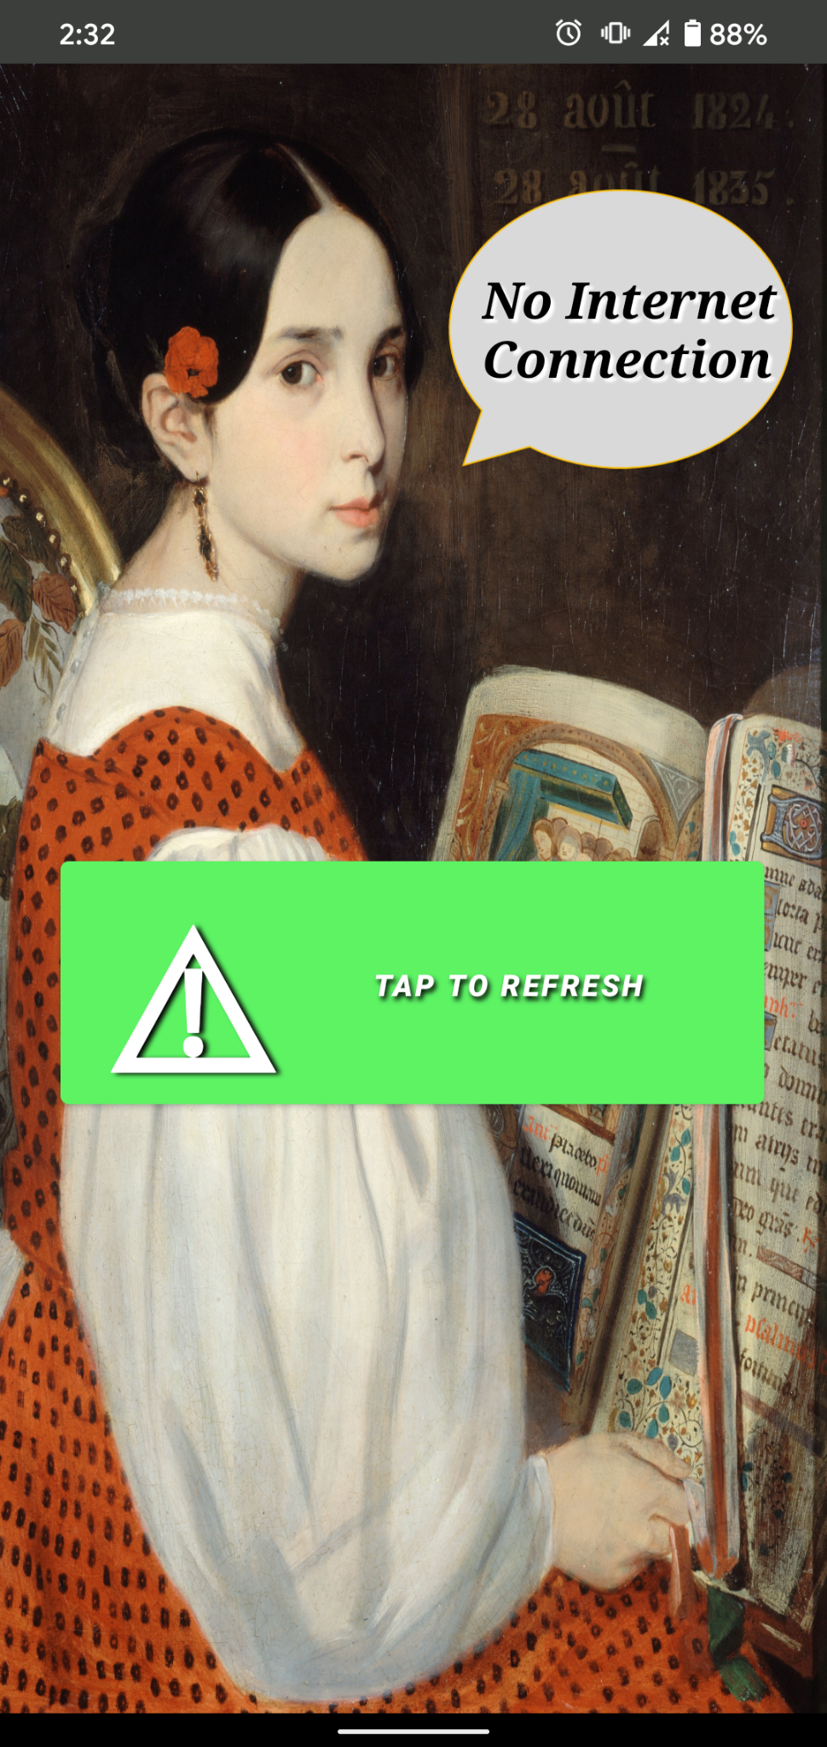
An Overview of New Technologies
Grant
Slide 5 of 13
Scroll View for a more modern app design
Animation to provide a visually tantalizing app
Map Clustering technologies
Cross-Page Connections for a seamless experience
Warnings for loss of connection
Speaker: Grant Saylor
Notes:
In capstone 3 we have added various new technologies to Virtual Library such as infinitely scrolling pages, map pin clustering for visual cleanliness, animation to our app, which you can see on the right – implemented via API calls to OpenLibrary, cross activity connection for better ease of use, warning pages for loss of connection and fuzzy search, which you saw in our tech talk this quarter. A demo showcasing the major features of the app will follow.
For our first demo I’ll be handing it off to Anthony to showcase his primary work on virtual library, the searching screen.

Slide 7
Demo: Search Activity
Technology: Fuzzy Wuzzy API
Anthony
Slide 6 of 13
Type in user inputs to search for book titles by Title or Author
Incorporates fuzzy search to better and easier search results
Once a book is found, user can see which libraries contains this book.
Speaker: Anthony Tran
Notes:
Hi My name is Anthony and I’m going to be the one starting off our virtual library demo. It’s been a while since we last presented our android app, so to refresh your memories, let’s start off with the book search activity in our app.
(taps search for books)
When searching for books in our application, we ask the user to type in the book title they're looking for or the author of that book.
Let’s type in Naruto, vol. 1 in the search bar
(Types in Naruto, vol. 1)
As you can see typing in Naruto, vol 1 will populate the activity with books that are similar to the user input. If you haven’t watched our tech talk, our search logic utilizes fuzzy search algorithms to query and search for books in our database based off of the user input. It also will put books that are more likely the user request book higher than those below it.
Now let’s type in Naruto 5
(Start typing naruto 5)
If just type in naruto 5 vs the previous naruto, (comma) vol. 1, the fifth volume of naruto would be placed higher in the view because its title is much closer to the user input versus all any of the other volumes.
It also can try distinguishing misspelled words and names using the fuzzy search algorithm to find a result. Let’s try typing in this:
(starts typing joost az i em)
As you can see, misspelling just as i am with joost az i em can query and return the book fine.
Also, like i said before, users can search books by author as well.
(starts typing in kishimoto)
And like with the book titles, the fuzzy search also applies for authors
(Starts typing sisly teson)
Now that we know we can search for books in multiple ways, lets see what happens when we tap on a book.
First let’s type in “opal” to find the book “Artemis fowl and the opal deception”
(starts typing opal)
Now let’s tap that book.
(Taps artemis fowl opal deception)
A text box will populate the screen with at most three libraries that has this book in their inventory. The libraries shown are geo fenced so that only libraries that are about 5 kilometers away from your current location can be shown
If we click on “Kyle’s library”, the application will then leave the search activity and will be transferred to the maps activity, with Kyle’s library automatically pinpointed for the user to interact with.
(Taps Kyle’s library as i mention it)
Now i'm going to hand it off to Grant to talk more about the Maps activity.

Slide 8
Demo: Maps
Technology: Google Maps API
Grant
Slide 7 of 13
Easily Access Favorite Locations
Geo-restricted to your general neighborhood
Add/Remove/Name your library!
Uses Google Maps SDK/API
Libraries cluster to prevent visual clutter
Speaker: Grant Saylor
Notes:
Hi, it’s Grant again. I’d like to demo my primary focus on Virtual Library, which was the map screen. This activity utilizes the Google Maps SDK for Android to render the map technologies and is something I self-taught myself to create the implementation you see. As you saw, Anthony tapped on a library from his search screen and it zoomed into that specific location. Alternatively, this map screen is also accessible from the main landing page, however it will zoom into your GPS location. If I zoom in and out you can see that libraries will cluster themselves to make the map a bit more readable as more and more libraries get added. I’ll actually move myself to my current geolocation by tapping the button in the upper right.
<TAP GEOLOCATE BUTTON>
Now we’re in my neighborhood, Capitol Hill, Seattle. I’ve got a couple libraries around me such as <CLICK VIOLET> Violet and <CLICK BLM> Black Lives Matter. These names are derived from what the owner named them on the physical box.
Lets say that I wanted to check out a book from a library not near me, but still in my neighborhood. If I go there often I can add that to my favorite libraries and quickly get there with a tap <TAP FAV LIB CENTRAL LIB> now I’ve zoomed over to this library a few blocks away, but I notice that there are only two books here and recently there hasn’t been much I’ve enjoyed, I think I’ll remove this library from my favorite list so I have room for another. <LONG PRESS CENTRAL TO REMOVE> <ZOOM BACK HOME> Well, that was a bust, but not all is lost, because there is much more you can do with the map screen. I think I want to create my own little library! You can do this easily by naming your library up at the top <GEOLOCATE AND NAME IT HARVARD AVE LIBRARY>, now that I’ve given it a name I can reposition it exactly where the box is and confirm it <CONFIRM IT> now because this is my library I think it makes sense to add it to my favorites <ADD TO FAVS, TAP ON IT>. As you can see, the map screen is a useful and powerful tool for navigating books in your area.
Next I’d like for you to all see Jiayi’s focus on Virtual Library, the library screen. Let’s zoom over to one of my favorites, Kyle’s Library to see a demo of that <GO TO KYLES>

Slide 9
Demo: Library View
Technologies: Gridview and Firebase
Jiayi
Slide 8 of 13
Show each Library’s info
Scrollable
Updated after user check in or out
Speaker: Jiayi Xu
Notes:
Hi, this is Jiayi. I am going to introduce the library view screen. The functionality of this page is to show each library's information, such as the library's title, and book covers, etcetera. On top of the screen shows the name of the library that the user has now selected. And the user can see which books are in this library,
and these books are presented with covers and available copies, also the title of the book.
Therefore, it is easier to see if the library has the books they want. Some books do not have covers, so we will use blank covers instead of real book covers. (You can see some of the covers show with brown covers.)
If you want to take away the specified book, you need to go to the checkout screen to do checkout. Similarly, if you want to add some books to this library, also need to go to the checkout screen to do check-in. (Kyle will explain this part in more detail.)
The available book copies will update asynchronously when the user doing check-in or check-out.
You can see that there is a delete button in the lower right corner, and only logged-in users can delete their library.
To make this screen better, our group made this page scrollable instead of multiple views. To make this screen scrollable, we used the Grid View and it will create grids dynamically, and no need to worried about how many covers in each library. When we add a book or delete a book every time, it will dynamically add a grid or delete a grid at the same time.
To implement this page, the technologies of this page are reading data from Firebase and using Grid View to present data.
Now, I will hand it over to Kyle to introduce check-in and check-out. Thank you.

Slide 10
Demo: Barcode Scanner and Checkout Log
Technologies: Google Vision and OpenLibrary API
Kyle
Slide 9 of 13
Implements Google Vision to detect/read barcodes
Connects with Open Library to find book info
Communicates with our Firebase Database to facilitate the transaction
Works with the User’s check-out log to maintain records
Speaker: Kyle Smith
Notes:
Hi everyone, this is Kyle and I’m going to be covering the final parts of our app, the barcode scanner and checkout log. This page is the checkout screen, and is where the user will use their device’s camera to scan a book barcode and then press a button for the app to correctly update the database for what the user is doing. When the user arrives at this page, the activity determines where the user came from previously, and that tells the activity whether this transaction is happening in a user’s collection, or within a library in our database. This information will play a role when the user taps the checkout button at the bottom. The black box within the frame is actually a video output for the device’s camera. We use Google Vision to detect when a barcode is in view of the camera, and then if the scanned barcode was for a book, we now can get the ISBN. Once that ISBN is obtained, we send out a call to our book API, Open Library, and grab pertinent information for our own DB, such as the title, author, publication date, and cover image. We populate the title of the book on screen to indicate to the user that the barcode has been scanned. Now the user can tap on the button to indicate whether they are checking this book into a library, or checking it out. Once they have that set, they can tap the button at the bottom to complete the transaction. At this point, all the book information is being sent to our database, and as that completes, we send a toast to the User and display the cover image for the book to indicate that the process completed. For our DB, we store information in a few different places to help keep things organized. We keep the complete records for each book in one branch of our DB, while just using the ISBN of the book as a key in other branches, such as the one for our libraries. For instance, the branch of our DB holding information about each library doesn’t need to know the publication date for the books, because that information is already stored elsewhere. We can simply keep a list of all the ISBNs registered at a particular little library, and when we need the information for those books, we can reference the other branch in our DB. If the user is checking in a brand new book, we create a new entry that holds all the book information, and then we update some values in the library branch, to indicate that it has a new book in stock, and we set it’s number of available copies to 1. We have a series of parameters for each transaction that this activity is able to handle, things like if the book is new to our DB or not, if the book is being checked in or checked out, and if the transaction is taking place in the user’s collection or the library’s circulation. Now that I’ve shown you the check-in process for a book, I want to show you the check-out log. When a user checks out a book from a library, we add that book, as well as the date and the library name, to a list that is maintained for that user. So if we now check this book out, we can then go back to the User Profile activity within our app, enter the Checkout log by tapping the button at the center of the screen, and now we are presented with a scrollable UI that tells us the “what, when and where” for all the books we have checked out. Once we return one of these books and scan the barcode at the library that we borrowed it from, it will be wiped from the checkout log.

Slide 11

Demo: Barcode Scanner and Checkout Log
Kyle
Slide 9 of 13
Speaker: Kyle Smith
Notes:
Hi everyone, this is Kyle and I’m going to be covering the final parts of our app, the barcode scanner and checkout log. This page is the checkout screen, and is where the user will use their device’s camera to scan a book barcode and then press a button for the app to correctly update the database for what the user is doing. When the user arrives at this page, the activity determines where the user came from previously, and that tells the activity whether this transaction is happening in a user’s collection, or within a library in our database. This information will play a role when the user taps the checkout button at the bottom. The black box within the frame is actually a video output for the device’s camera. We use Google Vision to detect when a barcode is in view of the camera, and then if the scanned barcode was for a book, we now can get the ISBN. Once that ISBN is obtained, we send out a call to our book API, Open Library, and grab pertinent information for our own DB, such as the title, author, publication date, and cover image. We populate the title of the book on screen to indicate to the user that the barcode has been scanned. Now the user can tap on the button to indicate whether they are checking this book into a library, or checking it out. Once they have that set, they can tap the button at the bottom to complete the transaction. At this point, all the book information is being sent to our database, and as that completes, we send a toast to the User and display the cover image for the book to indicate that the process completed. For our DB, we store information in a few different places to help keep things organized. We keep the complete records for each book in one branch of our DB, while just using the ISBN of the book as a key in other branches, such as the one for our libraries. For instance, the branch of our DB holding information about each library doesn’t need to know the publication date for the books, because that information is already stored elsewhere. We can simply keep a list of all the ISBNs registered at a particular little library, and when we need the information for those books, we can reference the other branch in our DB. If the user is checking in a brand new book, we create a new entry that holds all the book information, and then we update some values in the library branch, to indicate that it has a new book in stock, and we set it’s number of available copies to 1. We have a series of parameters for each transaction that this activity is able to handle, things like if the book is new to our DB or not, if the book is being checked in or checked out, and if the transaction is taking place in the user’s collection or the library’s circulation. Now that I’ve shown you the check-in process for a book, I want to show you the check-out log. When a user checks out a book from a library, we add that book, as well as the date and the library name, to a list that is maintained for that user. So if we now check this book out, we can then go back to the User Profile activity within our app, enter the Checkout log by tapping the button at the center of the screen, and now we are presented with a scrollable UI that tells us the “what, when and where” for all the books we have checked out. Once we return one of these books and scan the barcode at the library that we borrowed it from, it will be wiped from the checkout log.

Slide 12
Demo: Barcode Scanner and Checkout Log
Technologies: Google Vision and OpenLibrary API
Kyle
Slide 9 of 13
Implements Google Vision to detect/read barcodes
Connects with Open Library to find book info
Communicates with our Firebase Database to facilitate the transaction
Works with the User’s check-out log to maintain records
Speaker: Kyle Smith
Notes:
Hi everyone, this is Kyle and I’m going to be covering the final parts of our app, the barcode scanner and checkout log. This page is the checkout screen, and is where the user will use their device’s camera to scan a book barcode and then press a button for the app to correctly update the database for what the user is doing. When the user arrives at this page, the activity determines where the user came from previously, and that tells the activity whether this transaction is happening in a user’s collection, or within a library in our database. This information will play a role when the user taps the checkout button at the bottom. The black box within the frame is actually a video output for the device’s camera. We use Google Vision to detect when a barcode is in view of the camera, and then if the scanned barcode was for a book, we now can get the ISBN. Once that ISBN is obtained, we send out a call to our book API, Open Library, and grab pertinent information for our own DB, such as the title, author, publication date, and cover image. We populate the title of the book on screen to indicate to the user that the barcode has been scanned. Now the user can tap on the button to indicate whether they are checking this book into a library, or checking it out. Once they have that set, they can tap the button at the bottom to complete the transaction. At this point, all the book information is being sent to our database, and as that completes, we send a toast to the User and display the cover image for the book to indicate that the process completed. For our DB, we store information in a few different places to help keep things organized. We keep the complete records for each book in one branch of our DB, while just using the ISBN of the book as a key in other branches, such as the one for our libraries. For instance, the branch of our DB holding information about each library doesn’t need to know the publication date for the books, because that information is already stored elsewhere. We can simply keep a list of all the ISBNs registered at a particular little library, and when we need the information for those books, we can reference the other branch in our DB. If the user is checking in a brand new book, we create a new entry that holds all the book information, and then we update some values in the library branch, to indicate that it has a new book in stock, and we set it’s number of available copies to 1. We have a series of parameters for each transaction that this activity is able to handle, things like if the book is new to our DB or not, if the book is being checked in or checked out, and if the transaction is taking place in the user’s collection or the library’s circulation. Now that I’ve shown you the check-in process for a book, I want to show you the check-out log. When a user checks out a book from a library, we add that book, as well as the date and the library name, to a list that is maintained for that user. So if we now check this book out, we can then go back to the User Profile activity within our app, enter the Checkout log by tapping the button at the center of the screen, and now we are presented with a scrollable UI that tells us the “what, when and where” for all the books we have checked out. Once we return one of these books and scan the barcode at the library that we borrowed it from, it will be wiped from the checkout log.

Slide 13
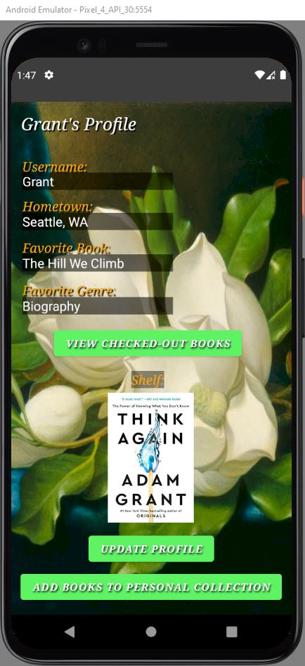
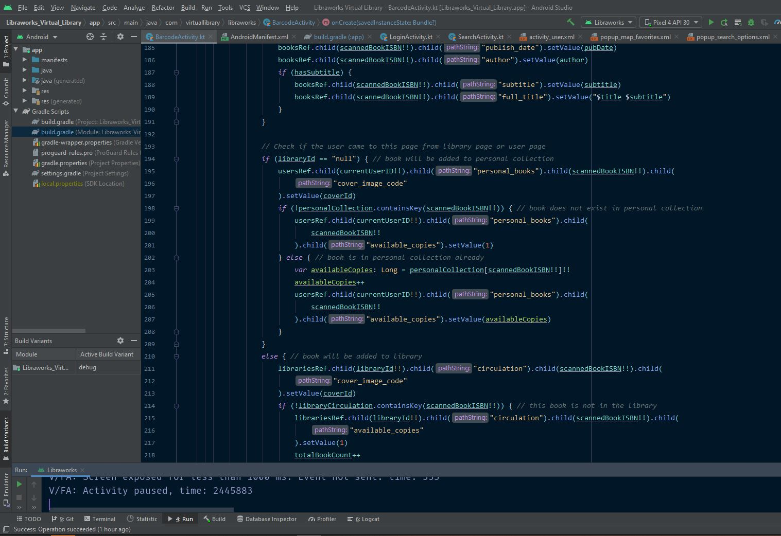

Challenges During Development
Kyle
Slide 10 of 13
Features we wanted, but had to shelve
Challenges learning Android Development
OpenLibrary is not as uniform as we’d like
Speaker: Kyle Smith

Slide 14
Development Tools Sources:
Kyle
Slide 11 of 13
Firebase: https://firebase.google.com/
Android Studio: https://developer.android.com/studio
Maps SDK: https://console.developers.google.com/apis/library/maps-android-backend.googleapis.com
ISBN Tutorial: https://medium.com/analytics-vidhya/creating-a-barcode-scanner-using-android-studio-71cff11800a2
Maps Tutorial: https://www.raywenderlich.com/230-introduction-to-google-maps-api-for-android-with-kotlin
Diagram.net (Formerly Draw.io): https://app.diagrams.net/
OpenLibrary API: https://openlibrary.org/dev/docs/api/books
Speaker: Kyle Smith

Slide 15
Public Domain Artwork Licenses:
Kyle
Slide 12 of 13
Connection Screen: https://commons.wikimedia.org/wiki/File:Auguste_de_Chatillon_-_L%C3%A9opoldine_Hugo.jpg
Barcode Screen: https://commons.wikimedia.org/wiki/File:Reimer_Librarian.jpg
Barcode UI: https://www.flickr.com/photos/34651674@N07/7258061584/
User/Library Screen: https://images.nga.gov/?service=asset&action=show_zoom_window_popup&language=en&asset=66024&location=grid&asset_list=109948,76165,66024,49028,148908,149152,149498,149347,149528,148885,149267,149357&basket_item_id=undefined
Speaker: Kyle Smith

Slide 16

Thank You for Watching
Questions and Answers to Follow
Kyle
Slide 13 of 13

